Slide 1
Remaining Useful Life of High Performance Computing
Professor:
Michele Lombardi
Presented By:
Davide Angelani
Yellam Naidu Kottavalasa
Usha Padma Rachakonda

Slide 2
Introduction
Remain useful Life refers to the remaining time of a machine before it requires a replacement. The prediction of the RUL helps to delay maintenance operations until they are really needed.
In the case of HPC it helps to forecast the remaining time before the next anomaly.
We propose a semi-supervised approach for estimating Remain Useful Life. In particular, we inject external knowledge about the problem in the form of constraint.

Slide 3

Recap
We model our constraint by the mean of a Semantic-based regularizer. This approach consists of extending the learning task with a set of constraint.
To choose the right λ we use the Lagrangian Duality
Then we define our constraint based on the monotonic behaviour of the RUL curve

Slide 4
Dataset
The data was collected from a monitored supercomputer hosted at CINECA and called "Marconi100"; the data was collected with a tool called Examon.
The dataset is composed of several node (there are not all the hundreds of nodes present on Marconi100, but some nodes with periods that also contained failures).
The information monitored on Marconi100's nodes is varied, ranging from the load of the different cores, to the temperature of the room where the nodes are located, the speed of the fans, details on memory accesses in writing / reading, etc.
The sampling rate of the data at the source varies between 5 and 10 seconds. However, in the data set the data are aggregated in 15-minutes intervals.

Slide 5
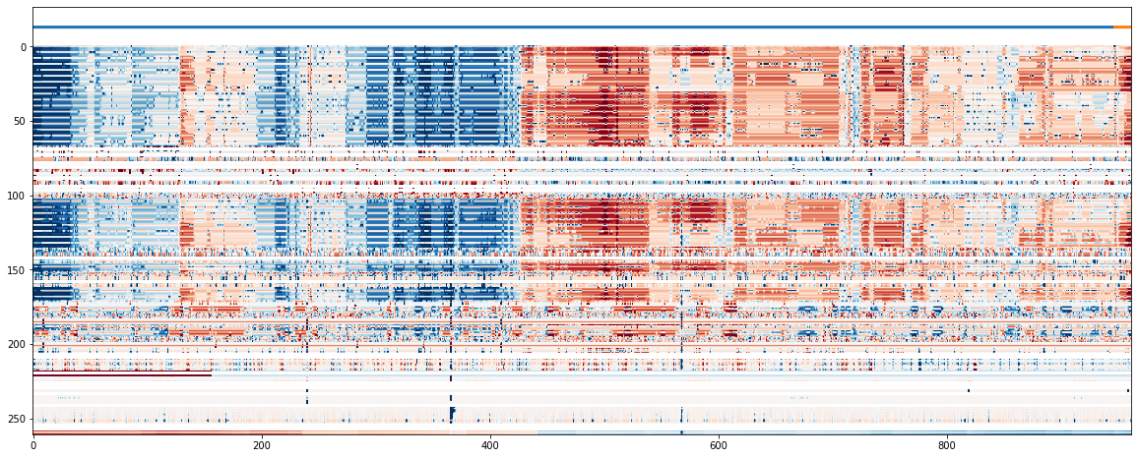
Dataset

Slide 6
Dataset
In order to forecast the next anomaly we split the dataset each time an anomaly is raised.
In this way the RUL value represents the remaining time until the next anomaly is going to happen.
Since an anomaly lasts several time step and recurs after a few time step, we define a threshold in which a minimum time step should pass before we split again the dataset.

Slide 7
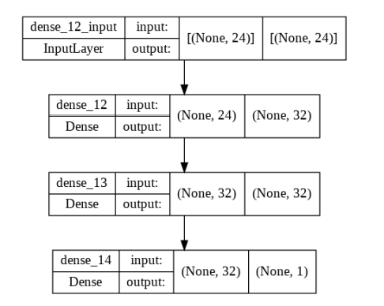
Baseline Model
We have defined our baseline model as a network of two hidden layers of 32 neurons.

Slide 8
Experiments: Models
We define three model:
the first model is the baseline model.
the third model applies both the semantic-based regulazer and the penalty term is chosen using the Lagrangian Dual Framework. It has a single penalty term computed on the average of all the constraint.
the fourth model applies both the approaches but it has multiple penalty term.

Slide 9
Experiments: Data
Since each node may have more than one failure. We consider each failure as an independent node.
Due to the difficulty of the task and the different sizes of each time series we have defined only two ratios of splitting for partitioning the data set.
20% supervised data, 55% unsupervised data
55% supervised data, 20% supervised data

Slide 10
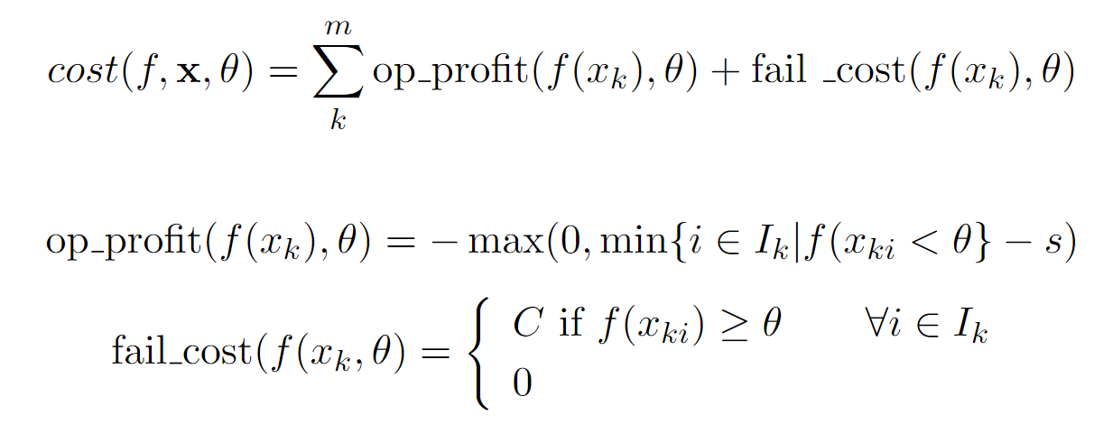
Evaluations
The goal of RUL estimation is not to achieve the best possible accuracy but to save as much as possible.
For a proper evaluation we have defined a cost model.

Slide 11
20% supervised 55% unsupervised

Slide 12
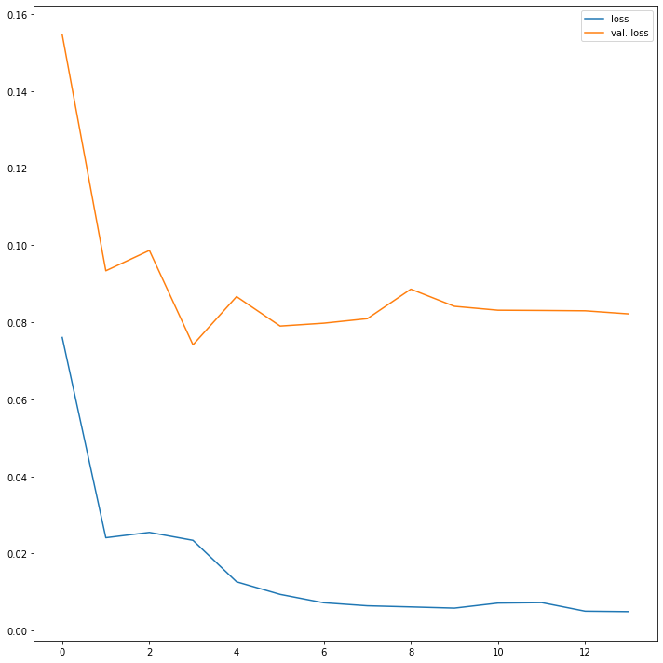
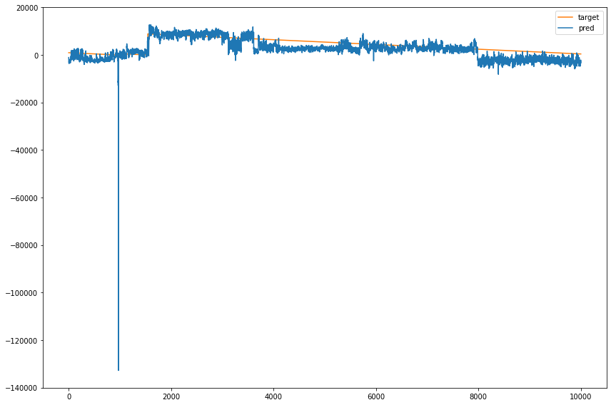
Baseline Model

Slide 13
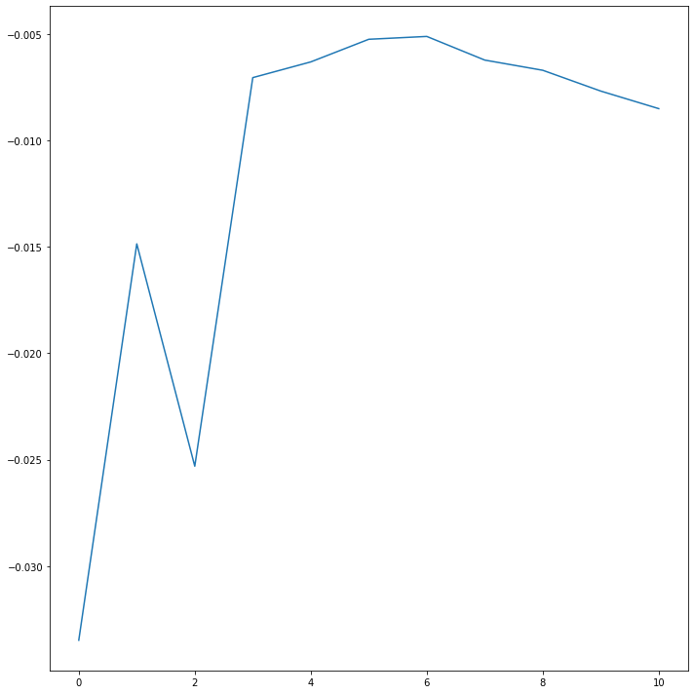
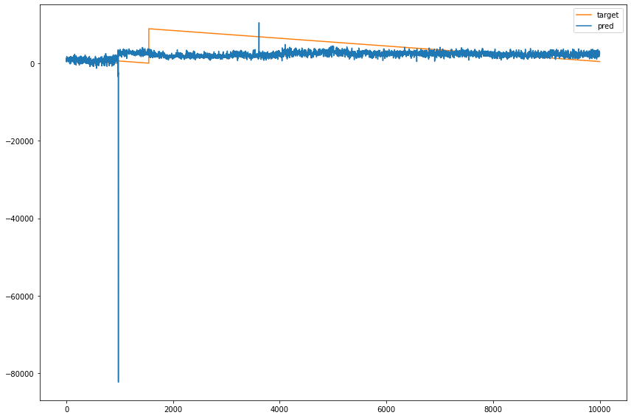
regularize updated using Lagrangian dual

Slide 14
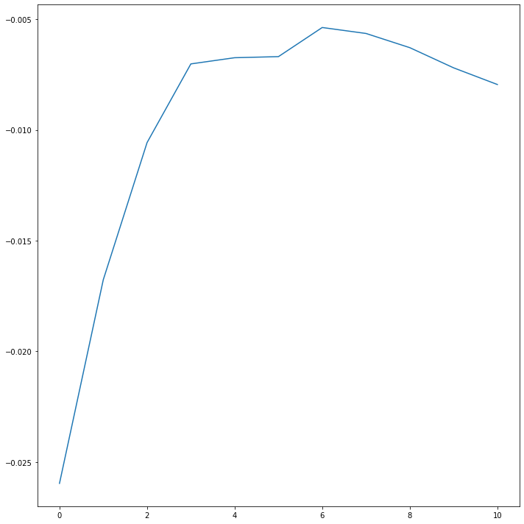
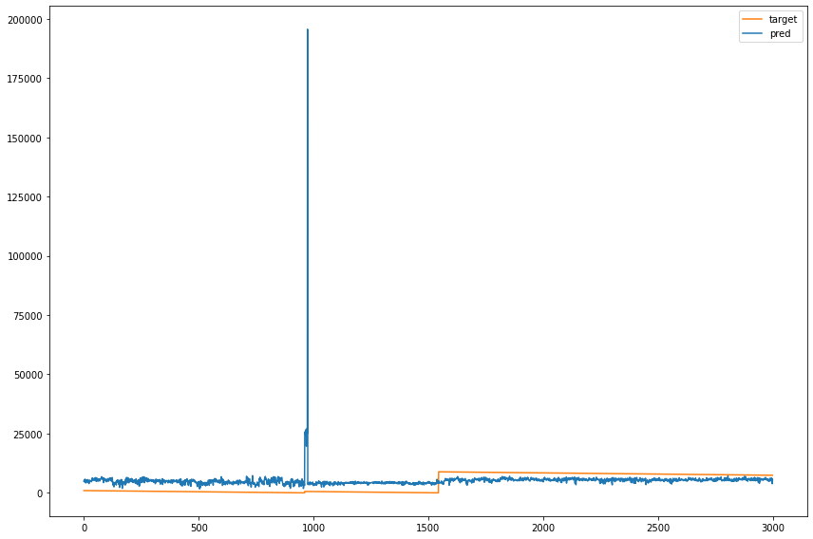
Multiple regularizes updated using Lagrangian dual

Slide 15
Cost model
 | Base | Updated Regularizer | Multiple Regularizer
Cost | 29985/90706/47847 | 26986/15963/57191 | 46986/461503/241619
Average fails | 0.14/0.14/0.15 | 0.10/0.15/0.14 | 0.24/0.65/0.70
Average slack | 1499.52/1968.83/2251.89 | 950.62/1200.79/1200.04 | 1045.62/395.26/1017.74

Slide 16
55% supervised 20% unsupervised

Slide 17
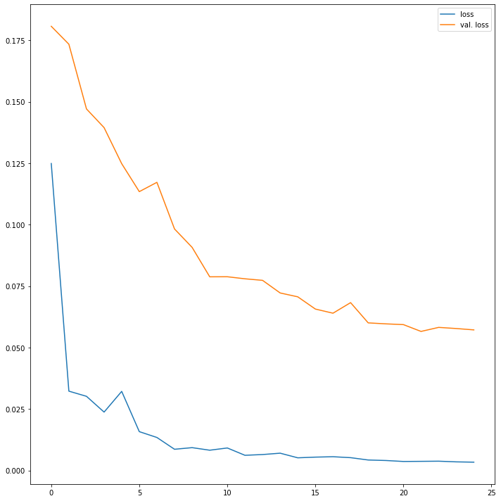
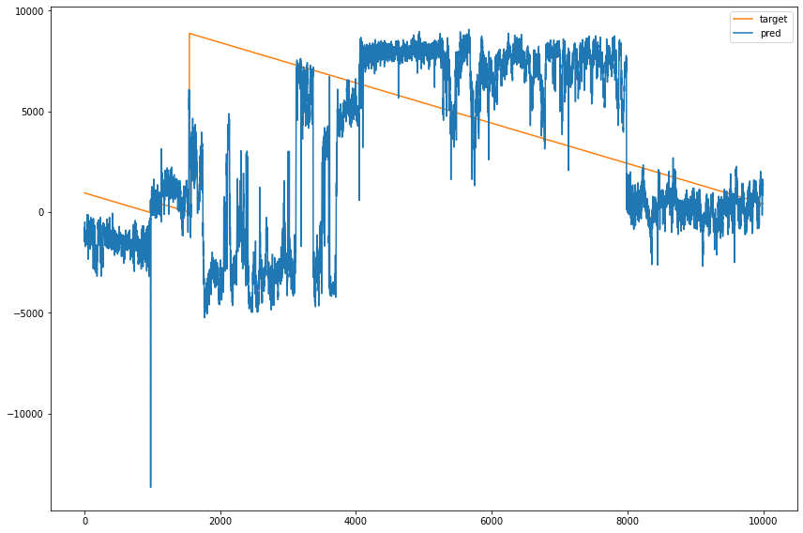
Baseline Model

Slide 18
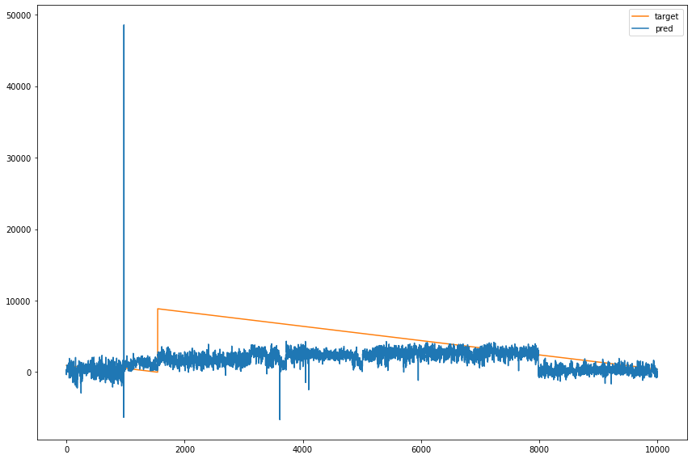
regularize updated using Lagrangian dual

Slide 19
Multiple regularizes updated using Lagrangian dual

Slide 20
Cost model
 | Base | Updated Regularizer | Multiple Regularizer
Cost | -4576/76858/9866 | 30498/66248/36837 | 30498/220222/134534
Average fails | 0.05/0.12/0.04 | 0.14/0.10/0.11 | 0.14/0.33/0.40
Average slack | 1155.81/1845.81/2331.48 | 1498.47/1979.33/2318.59 | 1498.47/1216..03/1384.48

Slide 21
Conclusion
The model did not yield the results we were expecting.
The performance of our models are much worse than the one of the baseline model.

Slide 22
References
Diligenti, Michelangelo, Marco Gori, and Claudio Sacc`a (2017). “Semantic-based regularization for learning and inference”. In: Artificial Intelligence 244. Combining Constraint Solving with Mining and Learning, pp. 143–16
Fioretto, Ferdinando et al. (2020). “A Lagrangian Dual Framework for Deep Neural Networks with Constraints”. In: CoRR abs/2001.09394

Slide 23


